Slide 1
Lifetime Denoising
Varun Mannam
EE department, University of Notre Dame
01/01/2020

Slide 2
Outline
Motivation and Noise type
Options for lifetime denoising
Block diagram at high level and low level
Preprocess and post-process
Results and metrics to compare
Conclusions

Slide 3
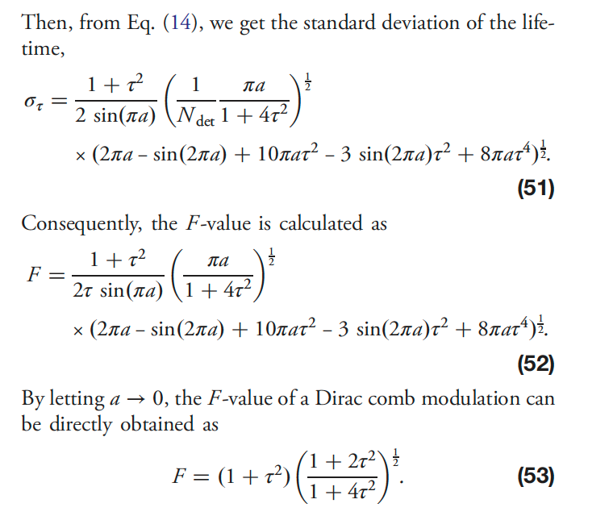
Motivation
Lifetime provides the additional contrast to the fluorescence intensity since it is independent of so many factors like power, concentration, movement of the animal etc.
But the lifetime information is noisy with low-SNR.
Only our setup has the lifetime information extraction capability.
To get high SNR, lot of averages are required with in the same FOV, which takes more time and can affect photobleaching of the sample.
Use machine learning model to perform lifetime denoising like the intensity denoising [1], but the lifetime noise type is not same as intensity noise (which is combination of Poisson noise and Gaussian noise) [2].
[1] Zhang, Yide, Yinhao Zhu, Evan Nichols, Qingfei Wang, Siyuan Zhang, Cody Smith, and Scott Howard. "A poisson-gaussian denoising dataset with real fluorescence microscopy images." In Proceedings of the IEEE Conference on Computer Vision and Pattern Recognition, pp. 11710-11718. 2019.
[2] Zhang, Yide, Aamir A. Khan, Genevieve D. Vigil, and Scott S. Howard. "Investigation of signal-to-noise ratio in frequency-domain multiphoton fluorescence lifetime imaging microscopy." JOSA A 33, no. 7 (2016): B1-B11.

Slide 4
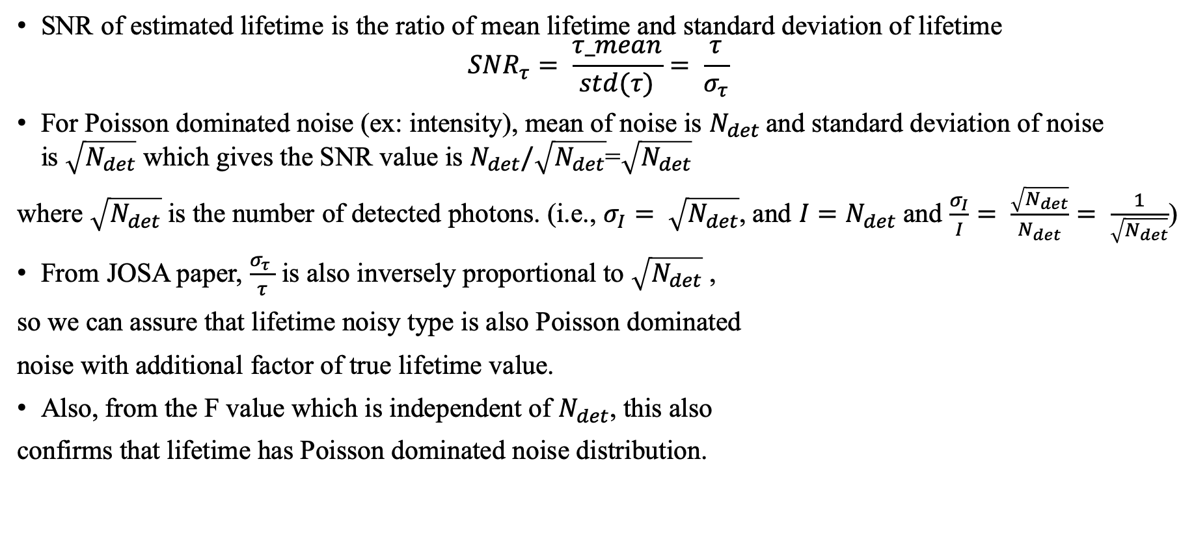
Lifetime noise type observations
SNR of estimated lifetime is the ratio of mean lifetime and standard deviation of lifetime
$${SNR}_{τ}= \frac{τ_mean}{std(τ)}= \frac{τ}{σ_{τ}}$$
For Poisson dominated noise (ex: intensity), mean of noise is $N_{det}$and standard deviation of noise is$\sqrt{N_{det}}$ which gives the SNR value is $N_{det}/\sqrt{N_{det}}$=$\sqrt{N_{det}}$
where $\sqrt{N_{det}}$ is the number of detected photons. (i.e., $σ_{I}= \sqrt{N_{det}}$, and $I=N_{det}$ and $\frac{σ_{I}}{I}= \frac{\sqrt{N_{det}}}{N_{det}}= \frac{1}{\sqrt{N_{det}}}$)
From JOSA paper, $\frac{σ_{τ} }{τ}$ is also inversely proportional to $\sqrt{N_{det}}$ ,
so we can assure that lifetime noisy type is also Poisson dominated
noise with additional factor of true lifetime value.
Also, from the F value which is independent of $N_{det}$, this also
confirms that lifetime has Poisson dominated noise distribution.

Slide 5
Options for machine learning lifetime denoising
Option1: Train the network from scratch with lifetime image dataset
Need to capture the lot of images → only our setup has lifetime imaging capability
Creation of dataset takes longer time and photobleaching on the samples for longer acquisitions
Can not cover all the microscopic modalities like in intensity denoising (widefield and confocal are missing here)
Need of image registration to get the ground-truth image in each FOV (stage movement is more)
Cells types are limited to only BPAE, mouse kidney and mouse brain here for fixed wavelength (800 nm): Zebrafish has lot of auto-fluorescence at 800nm.
Training a new model takes lot of time to find best tuning parameters (like learning rate, optimizer, machine learning NN model (ex: U-Net/noise2noise model)).
Evaluation metrics and comparison with other methods takes more time.

Slide 6
Cont
Option2: Use the existed intensity denoising network (even the lifetime noise is not combination of Poisson and Gaussian noise) and test the lifetime denoising performance
Only inference is used here: collection of dataset and model training is avoided here
Use the two-photon microscopy fixed cells (BPAE and mouse kidney)
Possible with zebrafish samples (later)
Use the pre and post process steps to convert the lifetime images for the network input and output
Evaluation metrics are required, i.e., the ground truth lifetime is required which can be obtained by averaging the samples with in the same FOV.
To get the ground truth image, image registration is required if the stage movement is more with in the same FOV.

Slide 7
Lifetime denoising: Option2
High-level block diagram of lifetime denoising is here
Image
denoising (Noise2Noise)
Noisy
Lifetime
denoised
Lifetime
Low-level block diagram of lifetime denoising is here
Image
denoising (Noise2Noise)
Post process
Pre
process
mat
file
Noisy
Lifetime
Read
.tif file
denoised
Lifetime
limit the lifetime from 0 to 10nsec.
restore the lifetime between 0 to 10nsec and use 1-4nsec in display of HSV image

Slide 8
Cont..
Preprocess step: replace the pixels whose lifetime is above 10nsec and below 0nsec with 0nsec save to a .tif file or read the .tif file and limit lifetime values between 0 to 10nsec (valid range) in python.
In mouse kidney, the number of pixels within the valid range is 98% and less than 2% is out of the range and in BPAE cells, the number of pixels within the valid range is 60% and around 40% is out of the range.
Divide the lifetime image by 10e-9 to get the image with in 0-1 range and passthrough the network for the denoised image
Postprocess step: add the value of 0.5 and multiply with 10nsec to get the denoised lifetime image. (within valid range)
Use the lifetime of 1-4nsec to display the results in HSV mode.

Slide 9
Image registration
Small PSNR improvement is observed in the denoised result, since to the target image is also noisy due to the stage movement.
Image registration is required to align the images by correcting the stage movement.
methods:
Register virtual stack -> imageJ (need input of valid range)
Correct_3D_drift -> imageJ (need input of valid range)
imregister -> Matlab (need input of valid range)
We used Matlab based image registration function (imregister()) with parameters: [optimizer, metric] = imregconfig(‘monomodal’) (all images are captured using the same sensor)
Where optimizer: RegularStepGradientDescent and Properties: GradientMagnitudeTolerance: 1.000000e-06 -> epsilon value to say it is reached the convergence, MinimumStepLength: 1.000000e-06 -> lr_min (1e-8), MaximumStepLength: 1.000000e-02 -> initial lr -> 1e-3, MaximumIterations: 500 -> number of iterations (epochs), RelaxationFactor: 1.000000e-01 -> learning rate (eta) and metric is MSE.

Slide 10
BPAE samples dataset

Slide 11
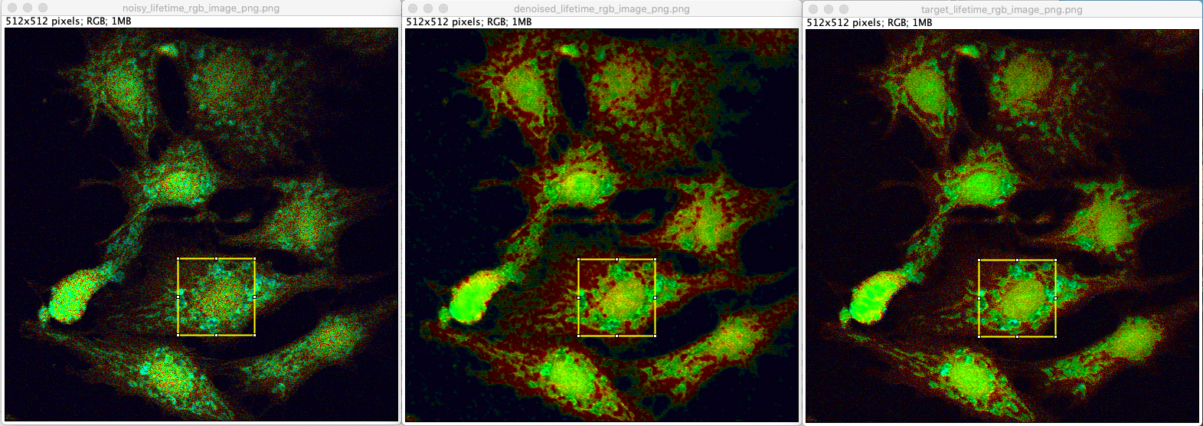
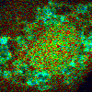
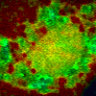
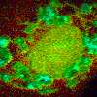
Full frame
Results: Noisy and denoised images (HSV)
ROI

Slide 12
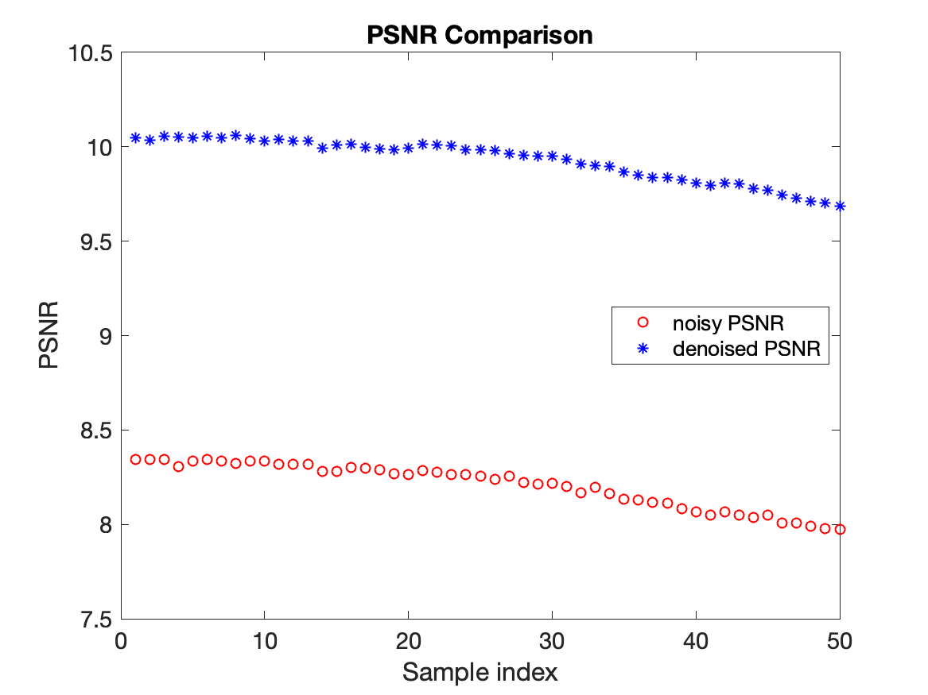
Results: Metrics and comparison
Image | PSNR (dB) on the HSV data | SSIM (Structural Similarity index)
Noisy lifetime image | 8.0485 | 0.0774
Denoised lifetime image (at index 43) | 9.8047 | 0.1066
difference in PSNR is 1.7561 dB
power is decreased as time progress -> shift in Z plane
Figure: PSNR of the lifetime images in the same FOV
Average (over 50 image) input PSNR = 8.2068 dB, denoised PSNR = 9.9311 dB with average difference of 1.7243 dB

Slide 13
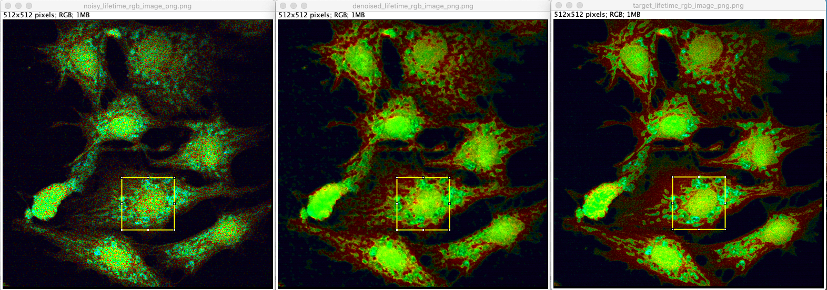
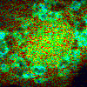
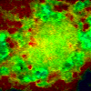
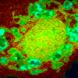
Full frame
Results: Noisy and denoised images (HSV)
(with registration)
ROI
Why the artifacts as red cells in denoised image within the ROI?

Slide 14
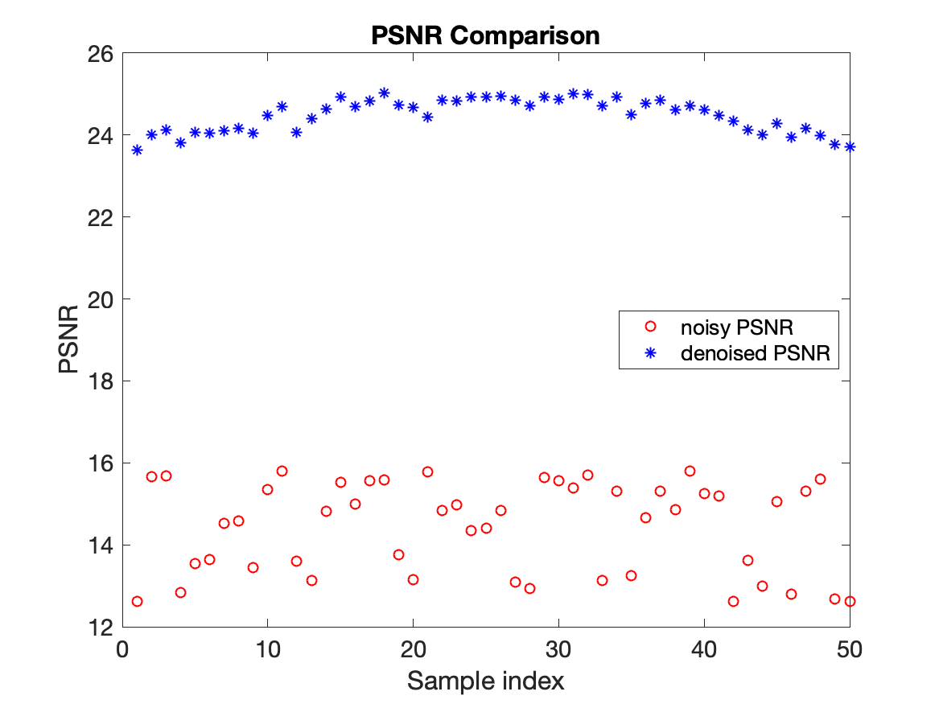
Results: Metrics and comparison
Image | PSNR (dB) on the HSV data | SSIM (Structural Similarity index)
Noisy lifetime image | 12.9356 | 0.1209
Denoised lifetime image (at index 28) | 24.7218 | 0.5351
difference in PSNR is 11.7861 dB
Figure: PSNR of the lifetime images in the same FOV
Average (over 50 image) input PSNR = 14.4259 dB, denoised PSNR = 24.4810 dB with average difference of 10.0552 dB

Slide 15
Summary of existing methods
Lifetime noise type is not same as intensity noise, but we used the same machine learning intensity denoising model to denoise the lifetime.
In the preprocess step: Image registration is required since the stage movement is more
Without image registration, denoising performance is minimal
Registration method: imregister with “rigid” method in MATLAB
Clearly, the denoising results with image registration shows there is an improvement of 9dB in PSNR between with and without denoising.
Artifacts: see the denoised lifetime images here

Slide 16
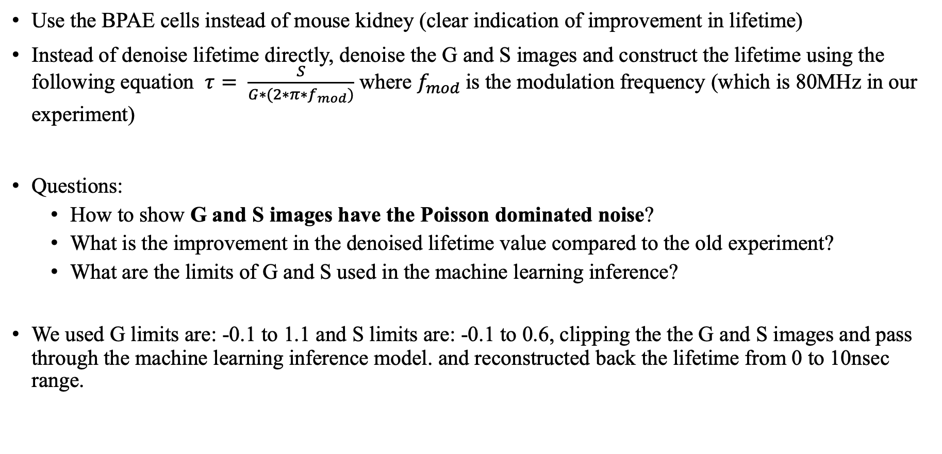
Suggestions
Use the BPAE cells instead of mouse kidney (clear indication of improvement in lifetime)
Instead of denoise lifetime directly, denoise the G and S images and construct the lifetime using the following equation $τ= \frac{S}{G∗(2∗π∗f_{mod})}$ where $f_{mod}$is the modulation frequency (which is 80MHz in our experiment)
Questions:
How to show G and S images have the Poisson dominated noise?
What is the improvement in the denoised lifetime value compared to the old experiment?
What are the limits of G and S used in the machine learning inference?
We used G limits are: -0.1 to 1.1 and S limits are: -0.1 to 0.6, clipping the the G and S images and pass through the machine learning inference model. and reconstructed back the lifetime from 0 to 10nsec range.
Notes:
In the JOSA paper tau is the ratio of 2 variables (u1+sigma1*Y1) / (u2+sigma2*Y2) where Y1 and Y2 are 0 mean and unit variance auxiliary variables.

Slide 17
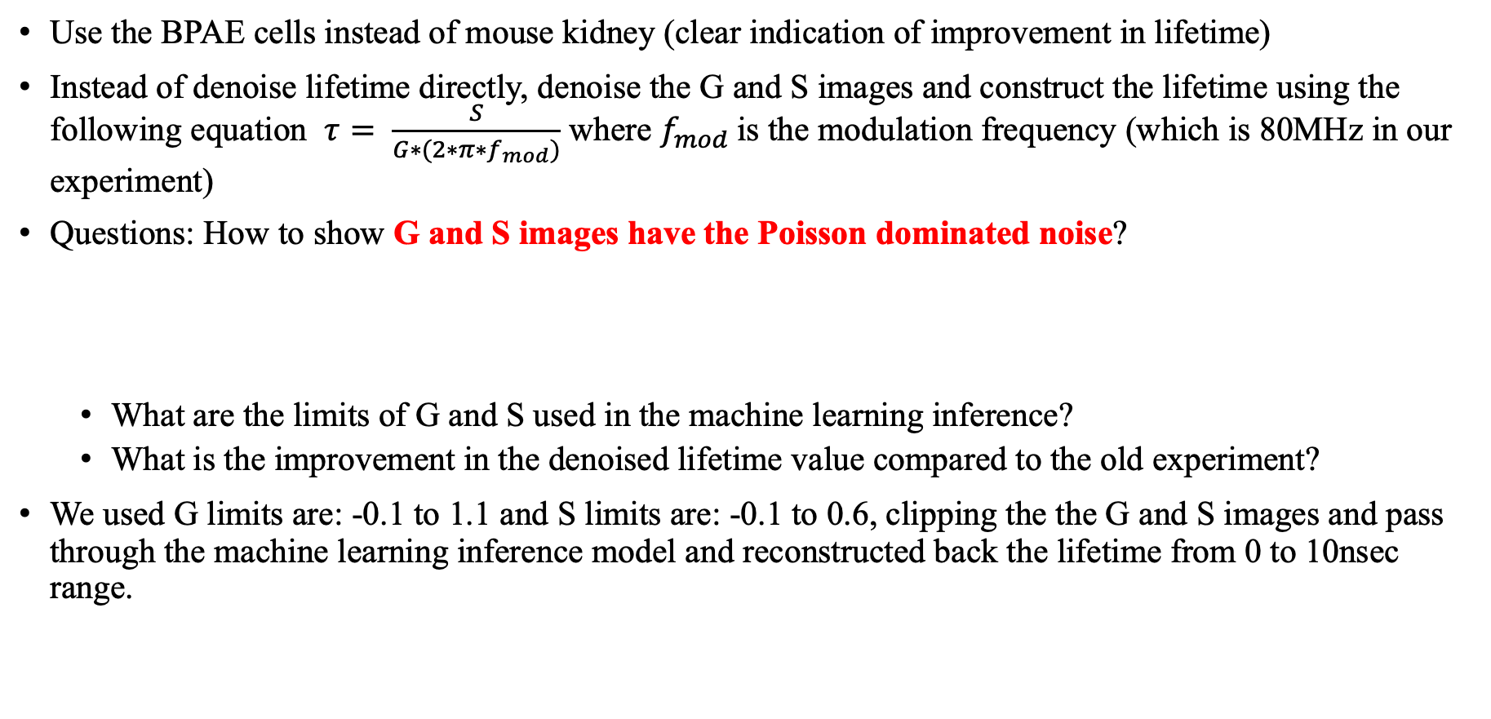
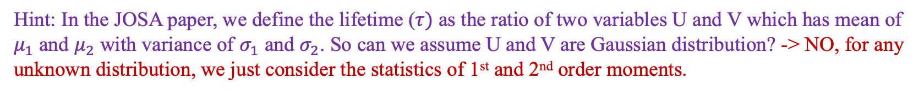
Lifetime denoising – Option3
Use the BPAE cells instead of mouse kidney (clear indication of improvement in lifetime)
Instead of denoise lifetime directly, denoise the G and S images and construct the lifetime using the following equation $τ= \frac{S}{G∗(2∗π∗f_{mod})}$ where $f_{mod}$is the modulation frequency (which is 80MHz in our experiment)
Questions: How to show G and S images have the Poisson dominated noise?
What are the limits of G and S used in the machine learning inference?
What is the improvement in the denoised lifetime value compared to the old experiment?
We used G limits are: -0.1 to 1.1 and S limits are: -0.1 to 0.6, clipping the the G and S images and pass through the machine learning inference model and reconstructed back the lifetime from 0 to 10nsec range.
Hint: In the JOSA paper, we define the lifetime ($τ)$ as the ratio of two variables U and V which has mean of $μ_{1}$ and $μ_{2}$ with variance of $σ_{1}$ and $σ_{2}$. So can we assume U and V are Gaussian distribution? -> NO, for any unknown distribution, we just consider the statistics of 1st and 2nd order moments.
Notes:
In the JOSA paper tau is the ratio of 2 variables (u1+sigma1*Y1) / (u2+sigma2*Y2) where Y1 and Y2 are 0 mean and unit variance auxiliary variables.

Slide 18
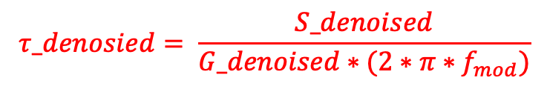
Lifetime denoising: Option3
High-level block diagram of lifetime denoising is here
Image
denoising (Noise2Noise)
G and S
images
denoised
G and S images
$$τ_denosied= \frac{S_denoised}{G_denoised∗(2∗π∗f_{mod})}$$
Low-level block diagram of lifetime denoising is here
Image
denoising (Noise2Noise)
Post process
Pre
process
mat
file
Noisy
G and S
images
Read
.tif file
denoised
G and S images
limit the G and S within valid range
restore the G and S images

Slide 19
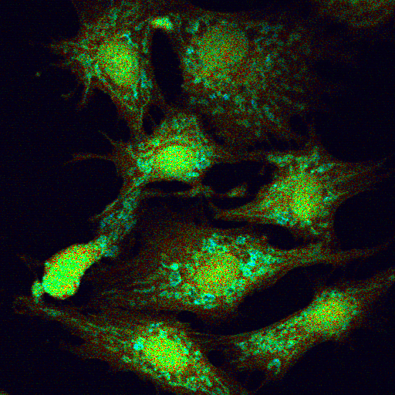
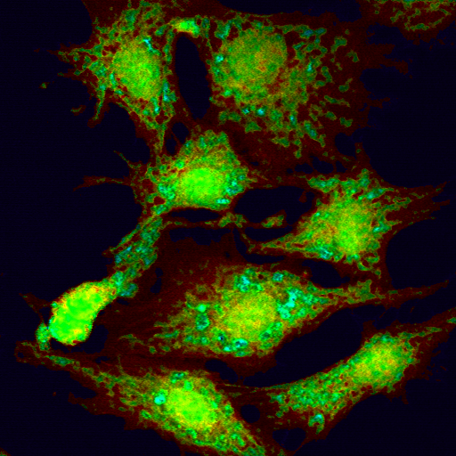
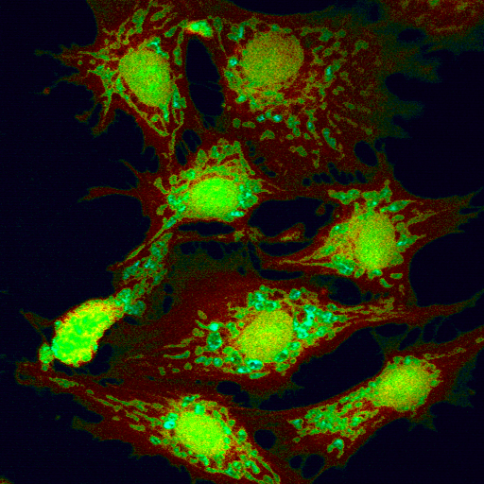
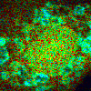
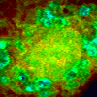
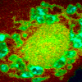
Noisy input
Denoised output
Target
Full frame
Results: Noisy and denoised images (HSV)
(with registration) From G and S denoising
ROI (100x100) at (position 225,300)
Adjusted brightness in noisy intensity image

Slide 20
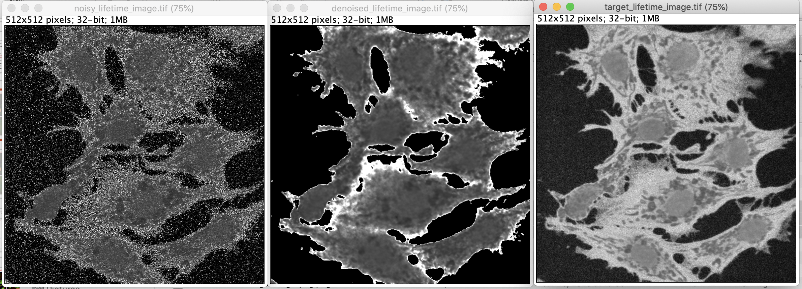
Results: Noisy and denoised images (with registration) From G and S denoising
Noisy input
Denoised output
Target
range of tau: 0 to 10nsec

Slide 21
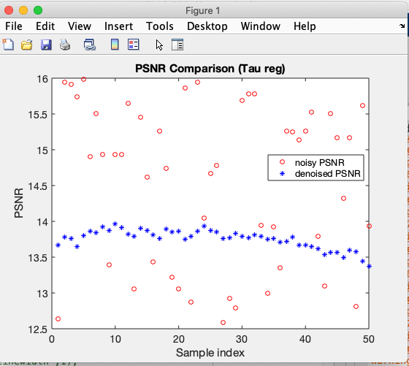
Results: Noisy and denoised images (HSV)
(with registration) From G and S denoising
PSNR check?

Slide 22
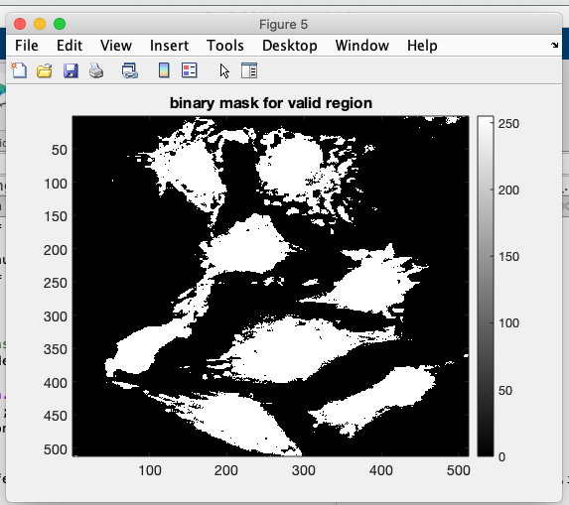
Select the mask area using ROIs
The area marked in blue circle is the noise region in the phasor diagram
get the mask of this noisy region and remaining image is the valid pixels
Export the segments and save this image as “noisy-region” where pixel value is zero. otherwise it is valid region with pixel value of 255.
Now compute the metric (PSNR) for the selected region only

Slide 23
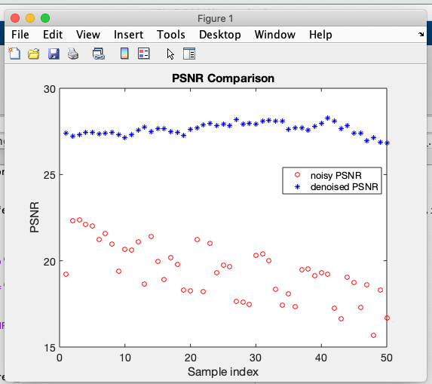
Lifetime denoising (metric on the valid region of pixels in lifetime)
Average PSNR of noisy input is 19.3551 dB
Average PSNR of denoised output is 27.6194
Improvement of 8.26dB (average over 50 images)
Clearly, PSNR of ROI is greater than PSNR of full image

Slide 24


28 $μ$m
28 $μ$m
28 $μ$m
(a)
(b)
(c)

